Slide 1
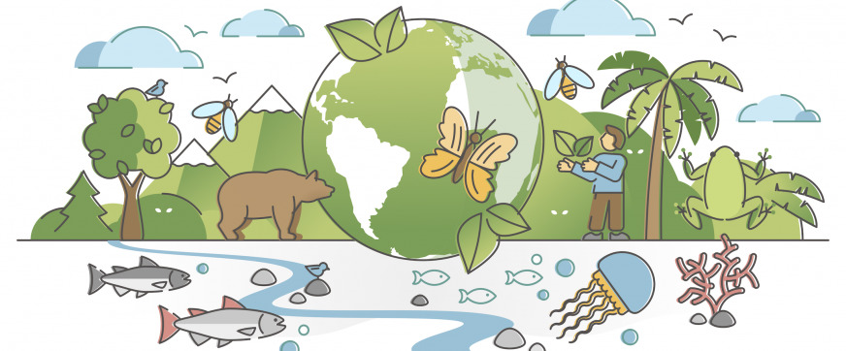
Biodiversity and Its Threats
Debrief

Slide 2
Biodiversity
What does the word “biodiversity” mean when you break it down into “bio” and “diversity”?
Why is high biodiversity generally considered a good thing for ecosystems?
How does having a greater number of genes in a gene pool help a population adapt to environmental changes?
What is ecosystem diversity, and how is it different from genetic and species diversity?

Slide 3
Biodiversity
What does the word “biodiversity” mean when you break it down into “bio” and “diversity”?
  “Bio” means life and “diversity” means differences, so biodiversity means the variety or differences of life
Why is high biodiversity generally considered a good thing for ecosystems?
  High biodiversity makes ecosystems healthier, more stable, and better able to recover from changes or disturbances (resilient)
How does having a greater number of genes in a gene pool help a population adapt to environmental changes?
  A larger gene pool increases the chance that some individuals have traits that allow them to survive any changes in the environment, this increases the chance that the species will continue to evolve and survive.
What is ecosystem diversity, and how is it different from genetic and species diversity?
  Ecosystem diversity is the variety of different ecosystems on Earth, while genetic and species diversity focus on variation within a species or within an ecosystem.

Slide 4
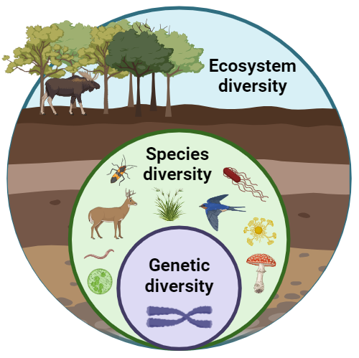

Slide 5
Ecosystem Services
Why are extinctions of plants and animals a problem for humans as well as for ecosystems?
What are ecosystem services, and why are they described as benefits “for free”?
3/4. Work together to provide one example of each type of ecosystem service (supporting, regulating, provisioning, and cultural).

Slide 6
Ecosystem Services
Why are extinctions of plants and animals a problem for humans as well as for ecosystems?
  we rely on ecosystems for services like food, clean water, oxygen production, and climate regulation—things we cannot do ourselves
What are ecosystem services, and why are they described as benefits “for free”?
  Ecosystem services are the natural processes that support life (like recycling nutrients or filtering water), and they are free because ecosystems perform them without cost to humans
3/4. Work together to provide one example of each type of ecosystem service (supporting, regulating, provisioning, and cultural).
  Supporting services → Soil formation: earthworms and decomposers break down organic matter, creating fertile soil that supports plant growth.
Regulating services → Climate regulation: forests absorb carbon dioxide, helping to slow global warming.
Provisioning services → Freshwater: rivers and aquifers provide drinking water for people and irrigation for crops.
Cultural services → Recreation: national parks give people opportunities for hiking, sightseeing, and connecting with nature.

Slide 7
Threats to Biodiversity
What does each letter in the acronym CHIPPO stand for?
Why is habitat loss and fragmentation considered one of the biggest current threats to biodiversity?
What is meant by the term “invasive species,” and what example was given in the lecture?
What role does the growing human population play in making other CHIPPO threats worse?

Slide 8
Threats to Biodiversity
What does each letter in the acronym CHIPPO stand for?
  Climate change, Habitat loss, Introduced species, Pollution, Population, and Overexploitation
Why is habitat loss and fragmentation considered one of the biggest current threats to biodiversity?
  Habitat loss and fragmentation reduce the size and quality of living spaces, isolating species and making survival and reproduction more difficult
What is meant by the term “invasive species,” and what example was given in the lecture?
  Invasive species are organisms introduced to ecosystems where they don’t naturally occur, often outcompeting or harming native species, such as zebra mussels in the Great Lakes
What role does the growing human population play in making other CHIPPO threats worse?
  Human population growth increases demand for land, food, and energy, which drives deforestation, pollution, and climate change, thereby intensifying the other CHIPPO threats

